Slide 1
K – Means Algorithm

Slide 2

What is K – Means Algorithm?
K-means clustering algorithm computes the centroids and iterates until we it finds optimal centroid.
It assumes that the number of clusters are already known.
It is also called flat clustering algorithm.
The number of clusters identified from data by algorithm is represented by ‘K’ in K-means.
The data points are assigned to a cluster in such a manner that the sum of the squared distance between the data points and centroid would be minimum.
It is to be understood that less variation within the clusters will lead to more similar data points within same cluster

Slide 3

Working of K-Means Algorithm
Step 1 − First, we need to specify the number of clusters, K, need to be generated by this algorithm.
Step 2 − Next, randomly select K data points and assign each data point to a cluster. In simple words, classify the data based on the number of data points.
Step 3 − Now it will compute the cluster centroids.
Step 4 − Next, keep iterating the following until we find optimal centroid which is the assignment of data points to the clusters that are not changing any more
4.1 − First, the sum of squared distance between data points and centroids would be computed.
4.2 − Now, we have to assign each data point to the cluster that is closer than other cluster (centroid).
4.3 − At last compute the centroids for the clusters by taking the average of all data points of that cluster.

Slide 4
K-means follows Expectation-Maximization approach to solve the problem. The Expectation-step is used for assigning the data points to the closest cluster and the Maximization-step is used for computing the centroid of each cluster.
While working with K-means algorithm we need to take care of the following things −
While working with clustering algorithms including K-Means, it is recommended to standardize the data because such algorithms use distance-based measurement to determine the similarity between data points.
Due to the iterative nature of K-Means and random initialization of centroids, K-Means may stick in a local optimum and may not converge to global optimum. That is why it is recommended to use different initializations of centroids

Slide 5
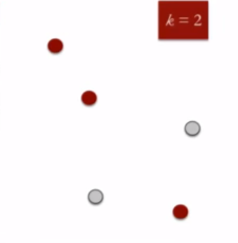
K Means Clustering
K means is an iterative clustering algorithm that aims to find local maxima in each iteration. This algorithm works in these 5 steps :
Specify the desired number of clusters K : Let us choose k=2 for these 5 data points in 2-D space.
Randomly assign each data point to a cluster : Let’s assign three points in cluster 1 shown using red color and two points in cluster 2 shown using grey color.

Slide 6
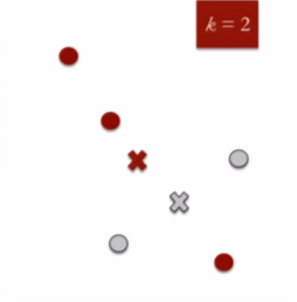
Compute cluster centroids : The centroid of data points in the red cluster is shown using red cross and those in grey cluster using grey cross.

Slide 7
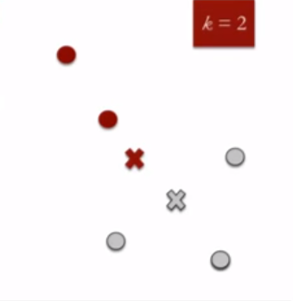
Re-assign each point to the closest cluster centroid : Note that only the data point at the bottom is assigned to the red cluster even though its closer to the centroid of grey cluster. Thus, we assign that data point into grey cluster

Slide 8
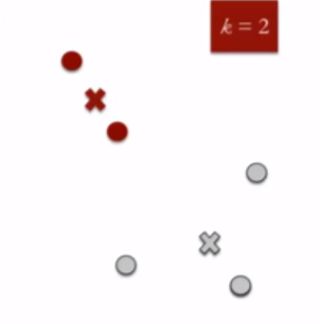
Re-compute cluster centroids : Now, re-computing the centroids for both the clusters.

Slide 9
Repeat steps 4 and 5 until no improvements are possible : Similarly, we’ll repeat the 4th and 5th steps until we’ll reach global optima. When there will be no further switching of data points between two clusters for two successive repeats. It will mark the termination of the algorithm if not explicitly mentioned

